Slide 1
Qualitative data analysis
Session facilitated by Constance Mackworth-Young and Mandi Tembo

Slide 2
outline
What is qualitative data?
Why do we want to analyse qualitative data?
How to generate themes
Coding qualitative data
Knitting together the story
A worked example

Slide 3
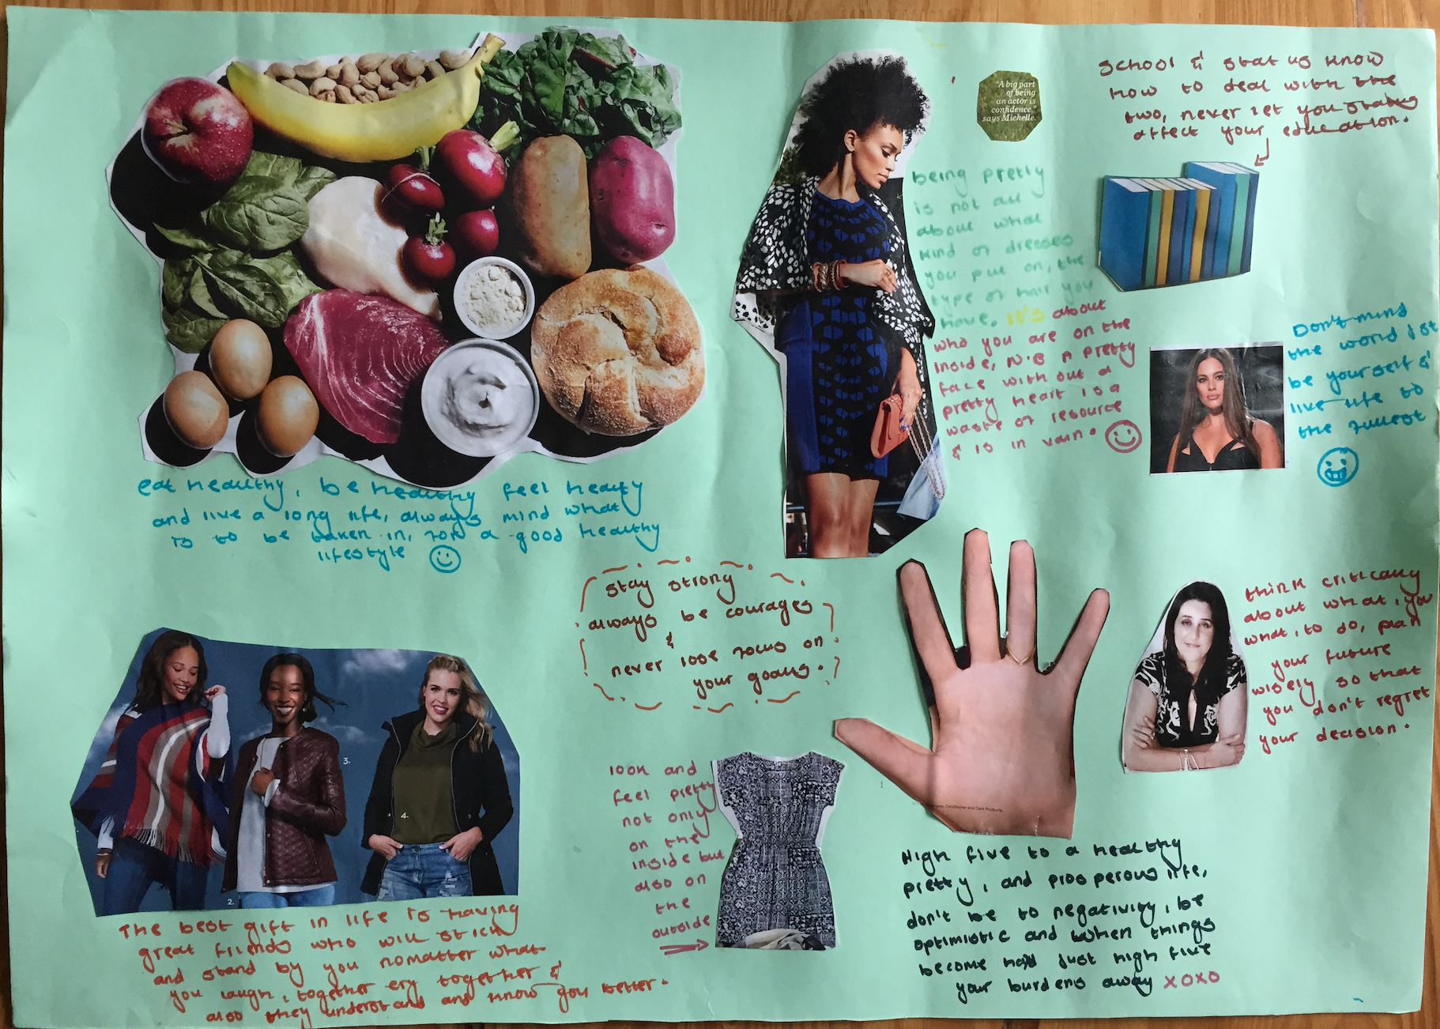
What is qualitative data?
In-depth interview transcripts
Focus group discussion transcripts
Observation notes
Written data e.g. diaries
Visual data e.g. collages, photographs

Slide 4
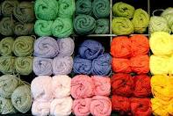
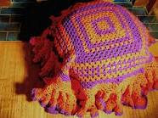
Why do we analyse Qualitative Data?
Answer questions
Understand the story
Draw out key themes
Understand different perspectives
(Credit for analogy to Sarah Bernays)

Slide 5
How to generate themes
Pre-determined themes (deductive)
Themes that emerge during data analysis (inductive)

Slide 6
Coding qualitative data
Organising the data based on themes
Sub-themes within themes
Coding across different data sources

Slide 7
Knitting together the story
Piecing together data from the different themes to tell the story

Slide 8
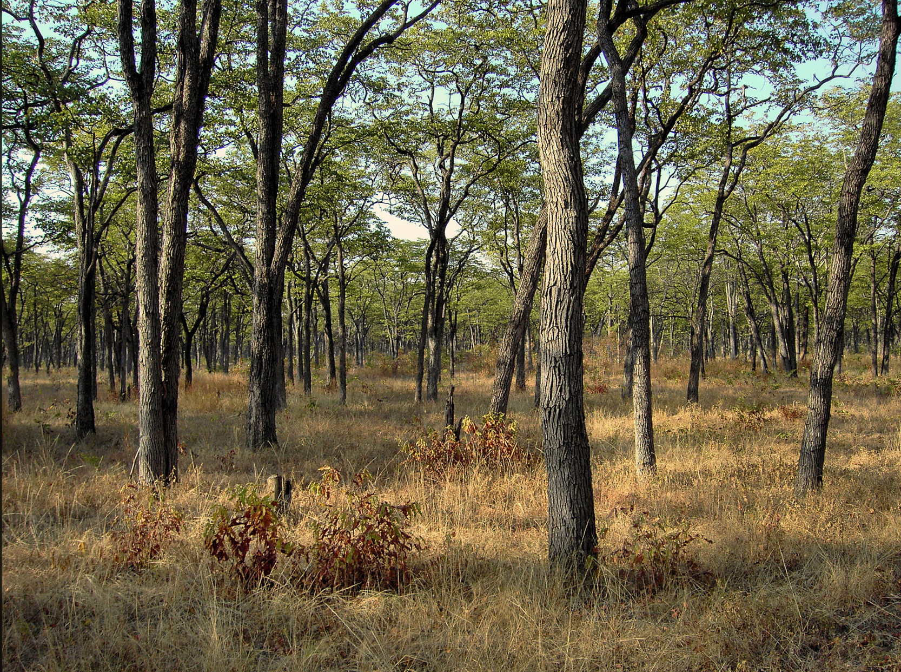
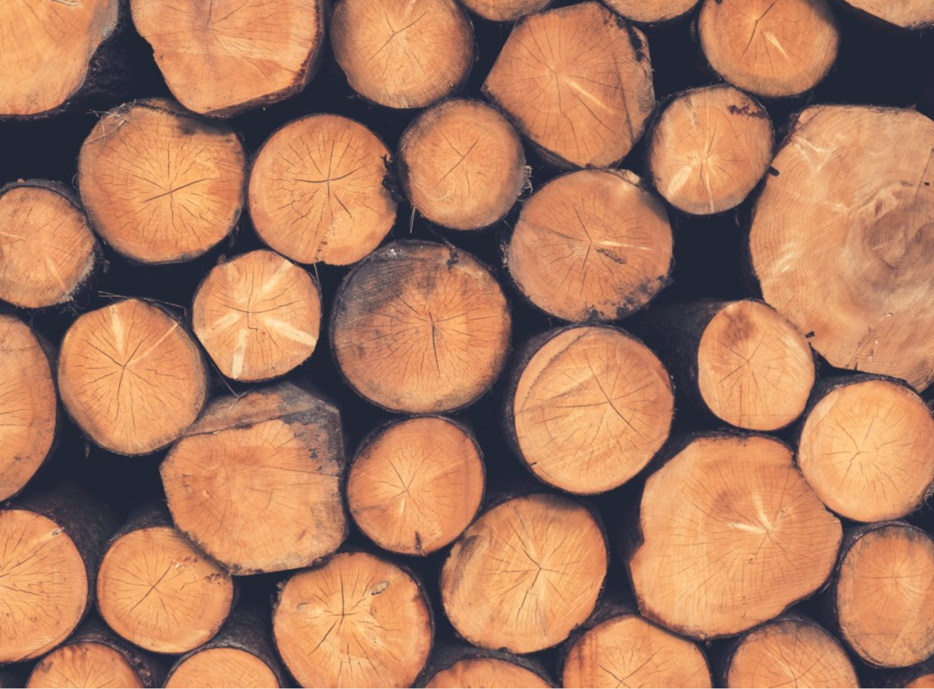
A different analogy

Slide 9
A worked example

