Slide 1
TYPHOID IN THE TIME OF COVID-19 BY: Leeroy Kakava, Brian Ngwenya & Shantelle Mazuru

Slide 2
RESEARCH STUDY
Has COVID-19 affected healthcare workers vigilance and management of Typhoid in Harare healthcare facilities?

Slide 3
STUDY RATIONALE
In this research ,we seek to understand how healthcare workers (HCW) are identifying (diagnosing) and managing Typhoid cases during the COVID period, taking into account the current climate of crisis, persistent resource constraints and the syndromic management of disease.

Slide 4
Objectives
To understand the views, work-related experiences and concerns of healthcare workers (HCW) regarding Typhoid.
To understand the views, work-related experiences and concerns of HCW regarding COVID-19
To understand how the COVID-19 pandemic has affected the HCW vigilance for and management of Typhoid

Slide 5
STUDY DESIGN
Research Type: Qualitative
We want to gain a deeper understanding of how COVID-19 and Typhoid are associated in the lived reality of HCWs identifying and managing Typhoid cases in Harare

Slide 6
Research METHODS
Observations- observing Outpatients Department (OPD) nurses upon request of consent, in the consultation room, in order to understand how they attend a patient, reach a diagnosis and ultimately manage the patient.
This was after getting consent from a patient at the OPD as to whether we can sit in or not.
In-depth interviews- one-on-one interviews with OPD nurses and pharmacists upon granting of consent.

Slide 7
SITE | IN-DEPTH INTERVIEWS | OBSERVATIONS
Mabvuku (Pilot) | 2 | 15
Kambuzuma (Pilot) | 3 | 21
Mbare (Main Study) | 8 | 34
Budiriro (Main Study) | 7 | 45
Totals | 20 | 115

Slide 8
STUDY PARTICIPANTS
Mainly Nurses and Pharmacists /Dispensary Assistant
Other health professionals- Clinic Hygienists, Counselors to also help us gain a general understanding on the typhoid and covid-19 management during the peak periods.

Slide 9
Variables | No. | % N=20
Age (years)
20-29 | 1 | 5
30-39 | 3 | 15
40-49 | 8 | 40
50+ | 5 | 25
Unknown | 3 | 15
Sex
Male | 5 | 25
Female | 15 | 75
Years of experience
0-5 | 2 | 10
6-10 | 2 | 10
11-15 | 2 | 10
>15 | 9 | 45
Unknown | 5 | 25
Occupation
Hygienist | 2 | 10
Counselor | 2 | 10
Dispensary Assistant | 1 | 5
Registered Nurse (RGN) | 2 | 10
RGN-Midwife | 10 | 50
SIC/NIC | 2 | 10
Mental Health Coordinator (Nurse specialist) | 1 | 5

Slide 10
When?- June 2021-July 2021
How?
We divided tasks between the three of us and at each visit we would interview 3 different participants.
Took turns to observe in the OPD and also doing observations upon obtaining consent
In-between interviews we took the time to do transcriptions and writing contact summaries.
STUDY PROCEDURES

Slide 11
STUDY PROCEDURES CONT’
Audio recording of interviewee upon consent
Writing interview transcripts (Verbatim)
Contact summaries
Field notes

Slide 12
DATA ANALYSIS
Thematic analysis of the interview transcripts and contact summaries
Creation of a coding framework

Slide 13
1. What are the views, work-related experiences and concerns of (HCW) regarding Typhoid?

Slide 15
2. What are the views, work-related experiences and concerns of HCW regarding COVID-19

Slide 16
3. How Has COVID-19 affected the HCW vigilance for and management of Typhoid?

Slide 18
DISCUSSION POINTS
Resource constraints are a key challenge within various community healthcare facilities, with staff shortages, lack of proper diagnostic tools, adequate PPE and WASH resources being the most pressing.
COVID-19 had a drastic effect not only on patients’ health but also on the healthcare system as a whole.
Healthcare worker vigilance for diseases like Typhoid declined massively in the time COVID-19, though some HCWs expressed that COVID-19 did not have any effect on them in terms of how they manage or pick Typhoid cases.
A section of HCWs also expressed that COVID-19 helped increase their vigilance for diseases like Typhoid.

Slide 19
RECOMMENDATIONS
Health planners and policy-makers need to create a scenario that enables HCWs to balance priorities in terms of managing traditional diseases like Typhoid and public health emergencies like COVID-19.
City Fathers and other relevant stakeholders need to prioritize procurement of modern laboratory equipment to limit referrals for diagnostics and coming up with subsidies for detergents and disinfectants to capacitate clinics
Health planners and policy-makers need to engage the government to allow those with urgent and chronic illnesses medical needs to be allowed healthcare access during lockdowns.

Slide 20
RECOMMENDATIONS
Health planners and policy-makers should advocate for creation of medicine subsidies to improve availability and access to medicines
City Fathers and other relevant stakeholders need to chip-in to address issues to do with infrastructure maintenance and WASH so as to curb the continued occurrence of typhoid in the community.
Training of more HCW and improvement of working conditions is needed to address the issues like staff shortages.

Slide 21
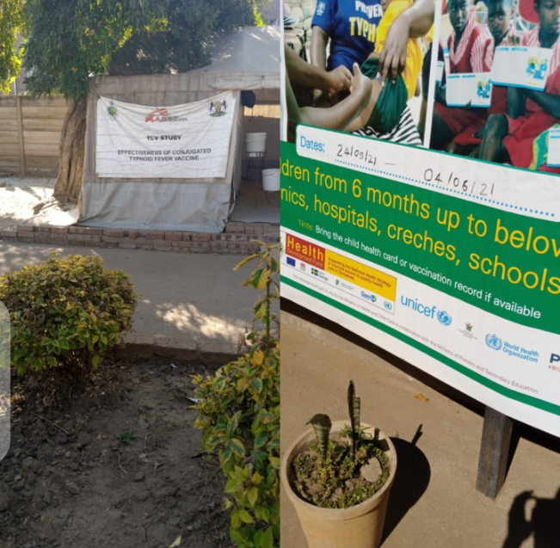
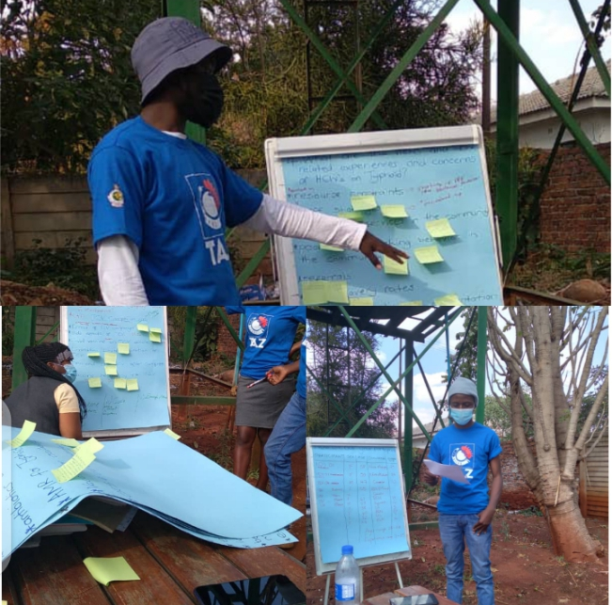
THANK YOU….

