Slide 1
Introduction to Research
Rashida Ferrand

Slide 2
What we will cover in this session
What is Research and why it is important?
Types of research
How to plan for and conduct research

Slide 3
What is Research?
Research is a process of steps used to collect and analyze information to increase our understanding of a topic or issue.
Three steps:
pose a question
collect data to answer question
present an answer to question

Slide 4
Some definitions
Original Research or Primary Research:
New information collected to produce new knowledge rather than presenting existing knowledge in a different form
Scientific Research:
Systematic and structured process is followed across each of the steps to answer your question, and documents the methods, results and conclusions

Slide 5
Why is Research important?
Builds knowledge and facilitates learning
Helps you know what you are “up against”
Helps you problem solve
Allows us to disprove lies and support truths
Builds your credibility
Understand the issue and increase public awareness
Introduces you to knew ideas, changes your position
Provides exercise for the mind and personal growth

Slide 6
Types of Research: Quantitative
Counting properties of a factor and/or their relationship:
Estimate the size of a phenomenon (descriptive)
Test hypothesis: is there association or causal relationships between factors
Outcome (independent) vs Explanatory (dependent) variable measured
Ask narrow question & collect numerical data in a sample
Data collection methods rely on random sampling and structured data collection instruments with options fitting into pre-determined response categories
Results can be summarized or compared using statistical methods
Findings applied to a larger populations if the data are collected using random sampling

Slide 7
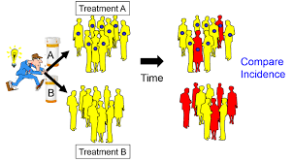
Observational vs Interventional study
Observational: Measuring what is happening (no intervention by researcher)
Interventional: assign an intervention and measure impact e.g. a trial
Trial: Participants assigned to different interventions and measures if one is better/worse/same as the other

Slide 8
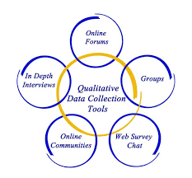
Types of Research: Qualitative
Understanding human behavior and the reasons such behavior, by asking a question and collecting data that is analyzed and searched for themes
Used for in-depth understanding to understand quantitative findings or to inform quantitative hypotheses
Not necessarily representative as a smaller number of subjects
Does not quantifiably measure variables or look to potential relationships between variables.
Linked to our joint understanding of social norms

Slide 9
Steps of Scientific Research
Define area of research or topic- what is the problem? is important, does it matter? Is Relate to what is known.
What is the purpose?
Research question or Hypothesis: a testable prediction of a relationship between two or more factors. Specific
Design and methods: Details on defining the factors and how they will be measured in the study.
Gathering of data: Consists of identifying a population and selecting samples, gathering information from or about these samples by using specific research instruments. The instruments used for data collection must be valid and reliable.
Analysis of data: Involves breaking down the individual pieces of data to draw conclusions about it.
Data Interpretation: This can be represented through tables, figures, and pictures, and then described in words.
Test, revising of hypothesis
Report and communicate findings and make recommendations

Slide 10
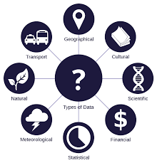
Data = Information
Primary Data: Data collected specifically for the research, such as through interviews or questionnaires.
Secondary Data: Data that already exists, such as census data, which can be re-used for the research.

Slide 11
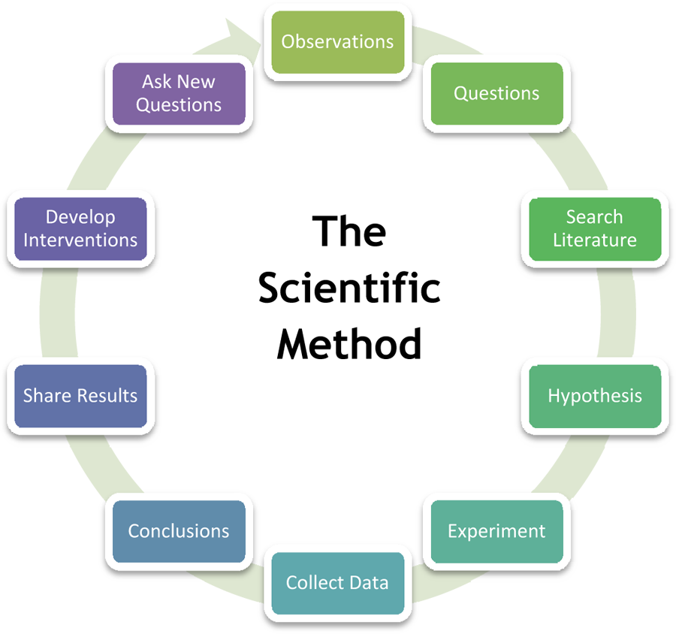

Slide 12
DESIGN YOUR RESEARCH
GROUP WORK
What is the research question and purpose?
How can we answer this question?
What do we need to know
What kind of research is most appropriate and why?
WHO, WHERE, WHEN
Define dependent / independent variable (quant)
How could we conduct this research?

